Slide 1

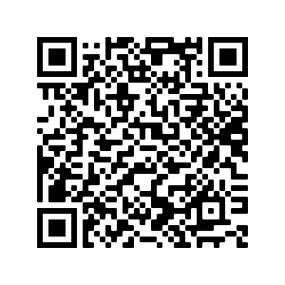
All the Trees of the Field Clapped Their Hands
Stephen Montalvo
Lyrics by Nikki Ummel

Slide 2
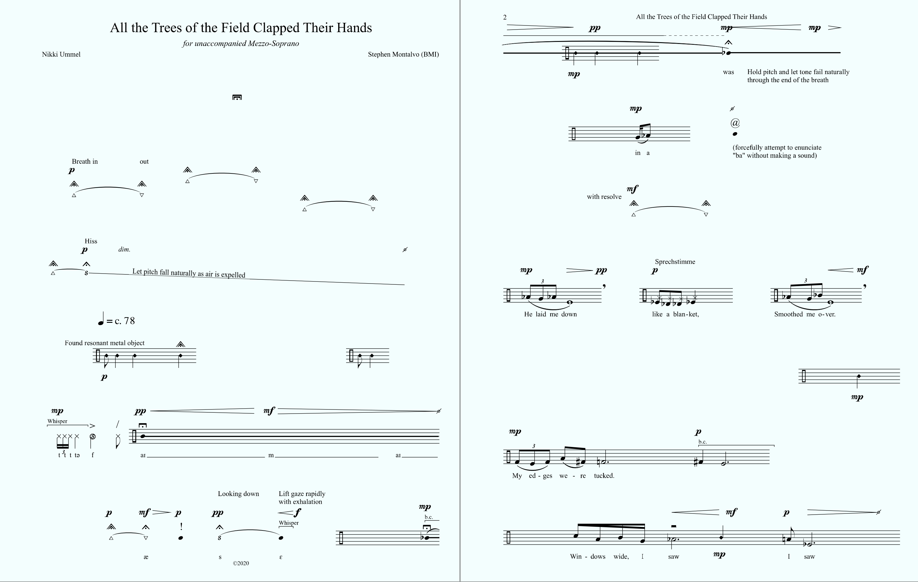

Slide 3
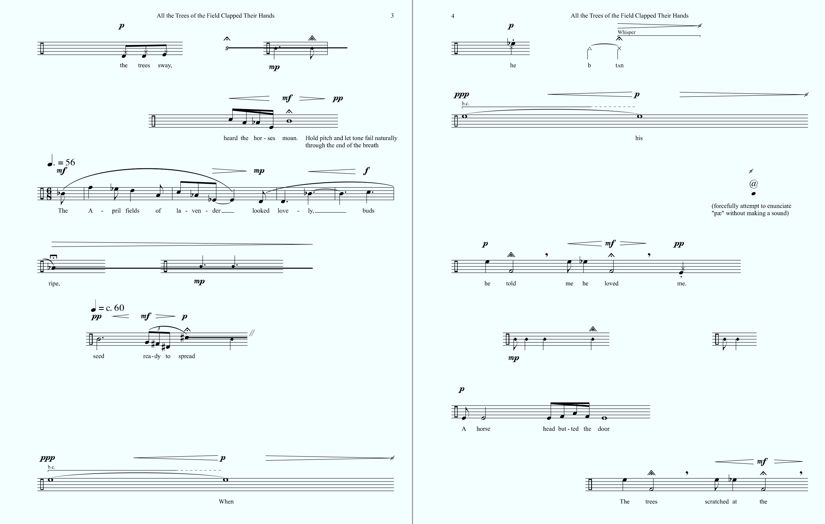

Slide 4
